Slide 1
PROBLEM STATEMENT
Classify a given research paper using Natural Language Processing.

Slide 2

CONTENTS
DATA OVERVIEW
INITIAL OBSERVATIONS
CHALLENGES
PROPOSED SOLUTION
RESULTS
RECOMMENDATIONS

Slide 3

DATA OVERVIEW.
DATA
20972 Entries
Title
Abstract
Computer Science
Physics
Mathematics
Statistics
Quantitative Finance
Quantitative Biology

Slide 4
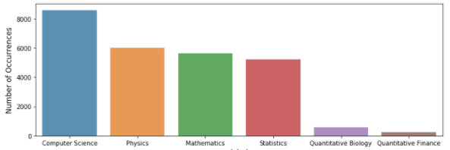
INITIAL OBSERVATIONS.
79 233
19 442
900
33
SINGLE
PAGES
MULTIPLE
PAGES
CORRUPT
PAGES
BLANK PAGES

Slide 5
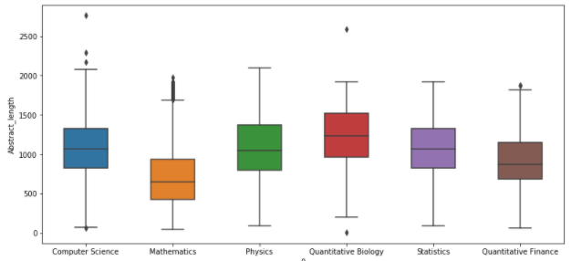
INITIAL OBSERVATIONS.
79 233
19 442
900
33
SINGLE
PAGES
MULTIPLE
PAGES
CORRUPT
PAGES
BLANK PAGES

Slide 6

CHALLENGE
Slow processing power

Slide 7

PROPOSED
SOLUTION
STEP 1:
Clean the text
STEP 2:
Convert text into features
STEP 3:
Train different Models
STEP 4:
Compare Models
STEP 5:
Choose the Best Model

Slide 8
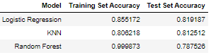
Results.
73.79%
58.25%
54.17%
16.72%
EMPLOYER NAME
GROSS
INCOME
NETT
INCOME
START
DATE

Slide 9

RECOMMENDATIONS
Include the KNN model on research website to assist scientists to readily filter 1000’s of research papers by field.

